Slide 1
Engineering Analysis and Design
(Modelling and Simulation)
Course Code: CO-207
Unit 1

Slide 2
Contents of Unit-1
Definition of System
Types of system: continuous and discrete
Modelling process and definition of a model
The nature of simulation
Simulation model - static, dynamic, deterministic stochastic continuous, discrete models.

Slide 3
Introduction to System
System is defined as a set of ideas or rules for organizing something; a particular way of doing something
A system is a collection of elements or components that are organized for a common purpose. For Example :
    A computer system consists of hardware components that have been carefully chosen so that they work well together and software components or programs that run in the computer.
    All of nature and the universe can be said to be a system. We've coined a word, ecosystem, for the systems on Earth that affect life systems.
In Terms of Simulation and Modelling :
    A systems is defined as a group of objects that are joined together in some regular interaction towards the accomplishment of some purpose. For Example:
    An Automobile Factory : Machine, component parts and workers operate jointly along Assembly line.

Slide 4
Introduction to System (cont.)
A system is defined to be a collection of entities e.g. people or machines that act and interact together toward the accomplishment of some logical end. [ Schimidt and Taylor(1970)].
In practice, what is meant by “the system” depends on the objectives of a particular study.
The collection of entities that comprise a system for one study might be only a subset of the overall system for another.

Slide 5
Introduction to System(cont.)
If one wants to study a bank to determine the number of tellers needed to provide adequate service for customers who want just to cash a check or make a savings deposit, the system can be defined to be that portion of the bank consisting of the tellers and the customers waiting in line or being served.
If, on the other hand, the loan officer and the safe-deposit boxes are to be included, the definition of the system must be expanded in an obvious way

Slide 6
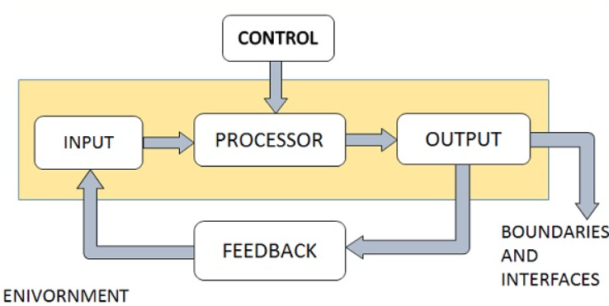
Introduction to System (cont.)
Understanding a System with Example
Component organized to form a Computer System

Slide 7
Components of System
Entity: An entity is an object of interest in a system. Ex: In the factory system, departments, orders, parts and products are The entities.
Attribute: An attribute denotes the property of an entity. Ex: Quantities for each order, type of part, or number of machines in a Department are attributes of factory system.
Activity: Any process causing changes in a system is called as an activity. Ex: Manufacturing process of the department.
State of the System: The state of a system is defined as the collection of variables necessary to describe a system at any time, relative to the objective of study. In other words, state of the system mean a description of all the entities, attributes and activities as they exist at one point in time.

Slide 8
Components of system (cont.)
Event :An event is defined as an instantaneous occurrence that may change the state of the system.
Endogenous System: The term endogenous is used to describe activities and events occurring within a system. Ex: Drawing cash in a bank.
Exogenous System: The term exogenous is used to describe activities and events in the environment that affect the system. Ex: Arrival of customers.
Closed System: A system for which there is no exogenous activity and event is said to be a closed. Ex: Water in an insulated flask.
Open system: A system for which there is exogenous activity and event is said to be a open. Ex: Bank system.

Slide 9
Example of a System and its Component
System | Entities | Attributes | Activities | Events | State Variables
Banking | Customers | Account Balance | Making Deposits | Arrival, Departure | Number of customer waiting

Slide 10
State of the System
The state of a system to be that collection of variables necessary to describe a system at a particular time, relative to the objectives of a study.
In a study of a bank, examples of possible state variables are the number of busy tellers, the number of customers in the bank, and the time of arrival of each customer in the bank.

Slide 11
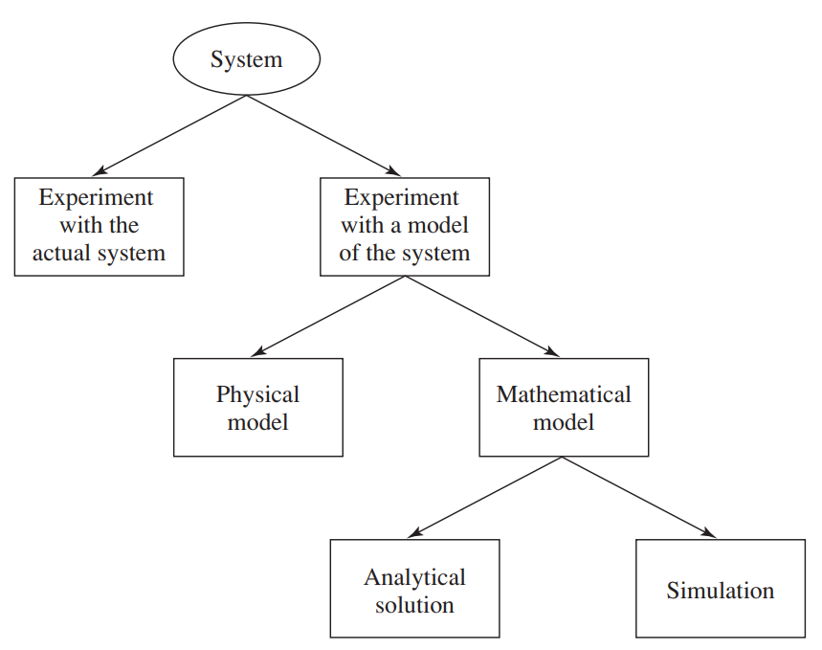
How to Study a System?

Slide 12
Experiment with the Actual System
To Improve the understanding of how a system operates we need to experiment over the system.
While analyzing or studying a system we must run the system over actual data.
When ever a real problem exist we can make a actual system and run the system to perform a set of task and see what are the results.
But is it possible and feasible to make a actual system directly to solve a problem?
Real World Problem
Actual System
Actual outputs

Slide 13
Experiment with a Model of the System
Now we have a real problem and we need to find a solution, but as we know it is nearly impossible.
Rather we can make a conceptual model first and then, do the experimentation over a model of a system.
This may lead to many advantages that we will study in upcoming slides…
Real World Problem
Experimenting on Conceptual model
Conceptual outputs

Slide 14
Physical Model
A physical model is a smaller or larger physical copy of an object.
A physical model is a simplified material representation, usually on a reduced scale, of an object or phenomenon that needs to investigated.
The model can be used to simulate the physical conditions involved (temperature, waves, speed etc.) and to predict the particular constraints of the situation.
These constraints can be taken into account and tested, and solutions implemented before undertaking the final steps of a project.
Physical models are widely used in fields involving geometry, thermodynamics and fluid mechanics: urban development, naval construction, aeronautics etc.

Slide 15
Mathematical Model
A mathematical model is a description of a system using mathematical concepts and language.
The process of developing a mathematical model is termed mathematical modeling.
Mathematical modeling is the art of translating problems from an application area into tractable mathematical formulations whose theoretical and numerical analysis provides insight, answers, and guidance useful for the originating application. Mathematical modeling:
      is indispensable in many applications
      is successful in many further applications
      gives precision and direction for problem solution
      enables a thorough understanding of the system modeled
      prepares the way for better design or control of a system

Slide 16
Analytical Solution
An analytical solution involves framing the problem in a well-understood form and calculating the exact solution.
Analytical solutions, also called closed-form solutions, are mathematical solutions in the form of math expressions.
  Transparency: Because analytical solutions are presented as math expressions, they offer a clear view into how variables and interactions between variables affect the result.
  Efficiency: Algorithms and models expressed with analytical solutions are often more efficient than equivalent numeric implementations. For example, to compute the solution of an ordinary differential equation for different values of its parametric inputs, it is often faster, more accurate, and more convenient to evaluate an analytical solution than to perform numerical integration.

Slide 17
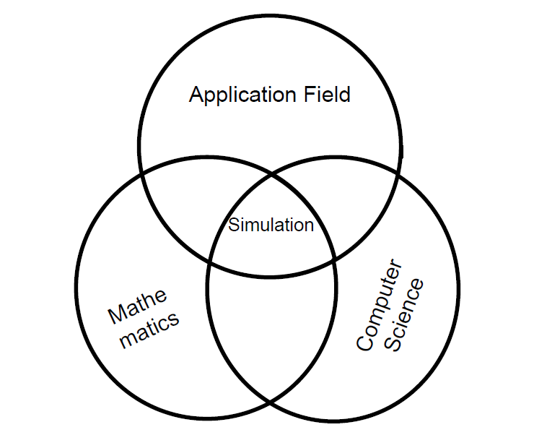
Simulation

Slide 18
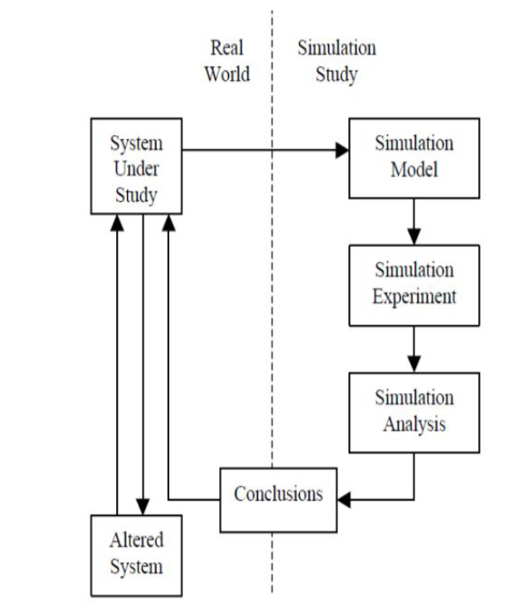
Introduction to simulation
Simulation Study
Step 1: Select a real world system for study.
Step 2: Create a Simulation Model for the selected real world system
Step 3: Perform the experiment over the simulation model
Step 4 : Simulation analysis
Step 5: Reach to conclusion
Step 6 : Use these conclusion to create the altered system
Step 7: Goto Step 1
Figure 1: Simulation Study Schematic

Slide 19
Definition of Simulation
A simulation is the imitation (Duplication) of the operation of real-world process or system over time.
Generation of artificial history and observation of that observation history.
A model construct a conceptual framework that describes a system.
The behaviour of a system that evolves over time is studied by developing a simulation model
The model takes a set of expressed assumptions:- Mathematical, logical- Symbolic relationship between the entities

Slide 20
History of Simulation
1940’s: Monte Carlo method is developed by physicists working on Manhattan project to study neutron scattering. Researchers include John von Neumann, Stanis law Ulan, Edward Teller, Herman Kahn
1950’s: First special-purpose simulation languages developed (e.g. IMSCRIPT by Harry Markowitz at RAND Institute)
1970’s: Research initiated on mathematical foundations of simulation
1980’s: PC-based simulation software developed, graphical user interfaces, object-oriented programming
1990’s: Web-based simulation, fancy animated graphics, simulation-based optimization, Markov-chain Monte Carlo methods Simulation has become ever more prominent as a method for studying complex systems in which uncertainty is present. In various surveys, simulation has been found to be the most frequently used tool of Operation Research practitioners. Simulation is an interdisciplinary subject, using ideas and techniques from Statistics, Probability, Number Theory, and Computer Science.

Slide 21
Goal of Modelling and Simulation
A model can be used to investigate a wide verity of "what if" questions about real-world system.
  Potential changes to the system can be simulated and predicate their impact on the system.
  Find adequate parameters before implementation.
So simulation can be used as- Analysis tool for predicating the effect of changes- Design tool to predicate the performance of new system. It is better Implementation.

Slide 22
When Simulation is the Appropriate Tool
Simulation enable the study of internal interaction of a subsystem with complex system
Informational, organizational and environmental changes can be simulated and find their effects
A simulation model help us to gain knowledge about improvement of system.
Finding important input parameters with changing simulation inputs.
Simulation can be used with new design and policies before implementation.
Simulating different capabilities for a machine can help determine the requirement.
Simulation models designed for training make learning possible without the cost disruption.
A plan simulation can be visualized with animated simulation
The modern system (factory, wafer fabrication plant, service organization) is too complex that its internal interaction can be treated only by simulation

Slide 23
Advantages of Simulation
New policies, operating procedures, information flows can be explored without disrupting ongoing operation of the real system.
New hardware designs, physical layouts, transportation systems and ... can be tested without committing resources for their acquisition.
Time can be compressed or expanded to allow for a speed up or slow-down of the phenomenon( clock is self-control).Insight can be obtained about interaction of variables and important variables to the performance.
Bottleneck analysis can be performed to discover where work in process, the system is delayed.
A simulation study can help in understanding how the system operates.

Slide 24
Disadvantages of Simulation
Model building requires special training. Vendors of simulation software have been actively developing packages that contain models that only need input (templates).
Simulation results can be difficult to interpret.
Simulation provides only estimates of solution, only solves one parameter at a time, can take a large amount of development and/or computer time

Slide 25
Difficulties of Simulation
Provides only individual, not general solutions
Manpower and time-consuming
Computing memory and time-intensive
Difficult so experts are required
Hard to interpret results
Expensive

Slide 26
Areas of Application
Manufacturing Applications
Semiconductor Manufacturing
Construction Engineering and project management
Military application
Logistics, Supply chain and distribution application
Transportation modes and Traffic
Business Process Simulation Health Care
Automated Material Handling System (AMHS)(Test beds for functional testing of control-system software)
Risk analysis (Insurance, portfolio,...)
Computer Simulation(CPU, Memory,...)
Network simulation (Internet backbone, LAN(Switch/Router), Wireless, PSTN (call center),...)

Slide 27
When to Use Simulation
Study internals of a complex system e.g. biological system
Optimize an existing design e.g. routing algorithms, assembly line
Examine effect of environmental changes e.g. weather forecasting
System is dangerous or destructive e.g. atom bomb, atomic reactor, missile launching
Study importance of variables
Verify analytic solutions (theories)
Test new designs or policies
Impossible to observe/influence/build the system

Slide 28
When to Use Simulation (cont.)
When it allows inspection of system internals that might not otherwise be
observable
Observation of the simulation gives insights into system behavior
System parameters can be adjusted in the simulation model allowing assessment of their sensitivity (scale of impact on overall system behavior)
Simulation verifies analysis of a complex system, or can be used as a teaching
tool to provide insight into analytical techniques
A simulator can be used for instruction, avoiding tying up or damaging an
expensive, actual system (e.g., a flight simulation vs. use of multimillion dollar
aircraft)

Slide 29
Steps of Simulation
Study For developing a simulation model, designing a simulation experiment, and performing simulation analysis are:
Step 1. Identify the problem.
Step 2. Formulate the problem.
Step 3. Collect and process real system data.
Step 4. Formulate and develop a model.
Step 5. Validate the model.
Step 6. Document model for future use.
Step 7. Select appropriate experimental design.
Step 8. Establish experimental conditions for runs.
Step 9. Perform simulation runs.
Step 10. Interpret and present results.
Step 11. Recommend further course of action.

Slide 30
Definition of a Model
Model: Simulation models consist of the following components: system entities, input variables, performance measures, and functional relationships.
A model is a representation of an actual system
• A model is an abstraction of the real system
• Simplifying assumptions are used to capture (only) important behaviors
Modelling : Modelling is the process of representing a model which includes its construction and working. This model is similar to a real system, which helps the analyst to predict the effect of changes to the system. In other words, modelling is creating a model which represents a system including their properties. It is an act of building a model
Formally we can define, Modeling is the application of methods to analyze complex, real-world problems in order to make predictions about what might happen with various actions.

Slide 31
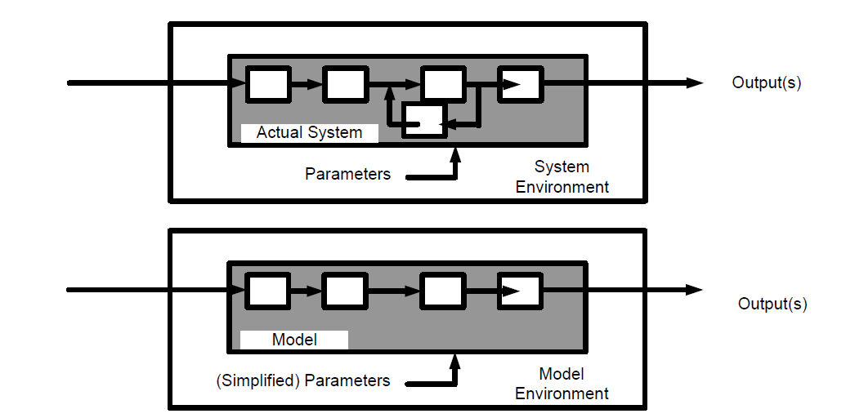
Introduction to Model
Pictorial Representation of System Model

Slide 32
The Modelling Process
Notice the problem in real world
Entities and their Relationship
Validation
Verification
Implementation
Model Frame and
Experimental Frame
Simulation Program
Revision
Output Analysis
Recommendation
Results

Slide 33
The Modelling Process
Step 1- Examine the problem: In this stage,, we must understand the problem and choose its classification accordingly, such as deterministic or stochastic.
Step 2- Design a model: In this stage, we have to perform the following simple tasks which help us design a model
  Collect data asper the system behavior and future requirements.
  Analyze the system features, its assumptions and necessary actions to be taken to make the model successful.
  Determine the variable names, functions, its relationships, and their applications used in the model.
  Solve the model using a suitable technique and verify the result. using verification methods. Next, validate the result.
  Prepare a report which includes results, interpretations, conclusion, and suggestions..
Step 3 Provide recommendations after completing the entire process related to the model. It includes investment, resources, algorithms, techniques, etc.

Slide 34
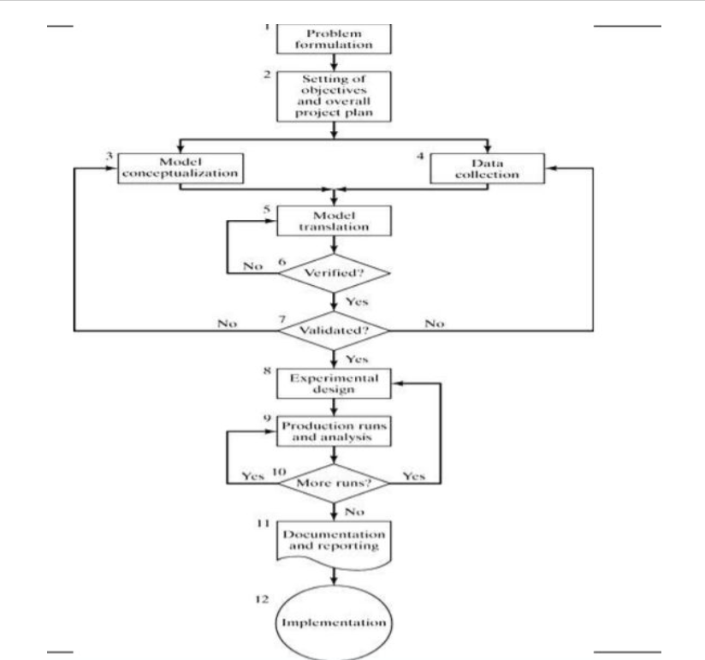
The Detailed Modelling Process

Slide 35
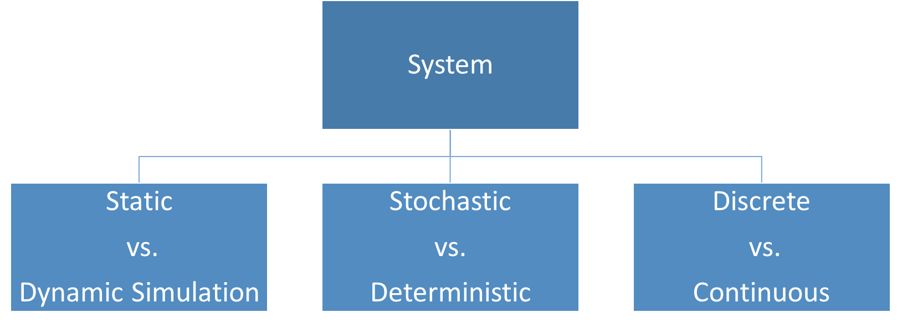
Classification of Models
A system can be classified into the following categories.

Slide 36
Classification of Models (cont.)
Static vs. Dynamic Simulation - Static simulation include models which are not affected with time. For example: Monte Carlo Model. Dynamic Simulation include models which are affected with time.
Stochastic vs. Deterministic Systems - Stochastic systems are not affected by randomness and their output is not a random variable, whereas deterministic systems are affected by randomness and their output is a random variable.
Discrete vs. Continuous Systems - Discrete system is affected by the state variable changes at a discrete point of time. Its behavior is depicted in the following graphical representation.

Slide 37
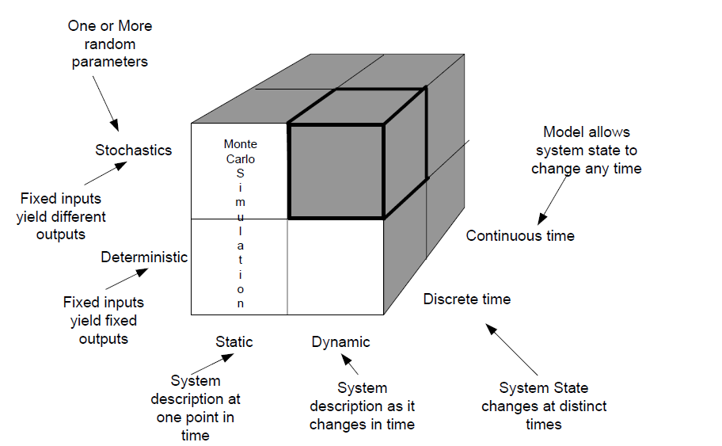
Classification of Models

Slide 38
Static vs. Dynamic-event simulation
We can also classify models as static or dynamic.
In a static model, we do not consider time, so that the model is comparable to a snapshot or a map.
For example, a model of the weight of a salamander as being proportional to the cube of its length has variables for weight and length, but not for time.
By contrast, in a dynamic model, time changes, so that such a model is comparable to an animated cartoon or a movie.
For example, the number of salamanders in an area undergoing development changes with time; and, hence, a model of such a population is dynamic.
Many of the models we consider in this text are dynamic and employ a static component as part of the dynamic model.
Definitions A static model does not consider time, while a dynamic model changes with time.
Static: A simulation of a system at one specific time, or a simulation in which time is not a relevant parameter for example, Monte Carlo & steady-state simulations.
Dynamic: A simulation representing a system evolving over time for examples, the majority of simulation problems.

Slide 39
Deterministic Vs. Stochastic- Event Simulation Model
A system exhibits probabilistic or stochastic behavior if an element of chance exists. Otherwise, it exhibits deterministic behavior.
A probabilistic or stochastic model exhibits random effects, while a deterministic model does not.
Deterministic: Randomness does not affect the behavior of the system.
The output of the system is not a random variable.
Stochastic: Randomness affects the behavior of the system. The output of the system is a random variable

Slide 40
Discrete vs. Continuous Event Simulation Model
When time changes continuously and smoothly, the model is continuous.
If time changes in incremental steps, the model is discrete.
A discrete model is analogous to a movie.
A sequence of frames moves so quickly that the viewer perceives motion. However, in a live play, the action is continuous.
Just as a discrete sequence of movie frames represents the continuous motion of actors, we often develop discrete computer models of continuous situations .
Definitions In a continuous model, time changes continuously, while in a discrete model time changes in incremental steps.
Continuous: State variables change continuously as a function of time (Fig 1) and generally analytical method like deductive mathematical reasoning is used to define and solve the system.
State Variable (S.V.) = f (t)

Slide 41
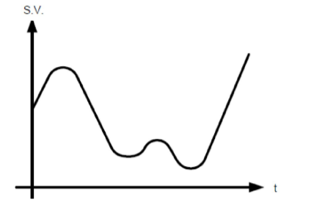
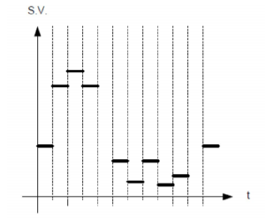
Discrete vs. Continuous Event Simulation Model
Discrete: State variables change at discrete points in time (Fig 2) and generally numerical method like computational procedures is used to solve mathematical models.
State Variable(S.V.) = f(n t)
Continuous Model behavior is shown
Discrete Model behavior is shown

Slide 42
Examples of Different Systems
Queue length at a cash machine: Stochastic, Discrete Time, Discrete System
The motion of the planets: Deterministic, Continuous Time, Discrete System
Logic circuit in a computer: Deterministic, Discrete Time, Discrete System
Flow of air around a car: Deterministic, Continuous Time, Continuous System
Closing prices of the 30 DAX shares: Stochastic, Discrete Time, Discrete System

